Slide 1
Sound Pixel Project
NSF REU
JULY 27th, 2012

Slide 2
Building a Frame
Design Concept
  Transportable, study, and easily constructed
Material: 80/20
  Lightweight aluminum alloy composite
  T-slot framing
Speakers
  Original Concept: independent sound emitters
  In Use: six sets of stereo speakers
Speaker Mounting
  Cable wiring and cable ties

Slide 3
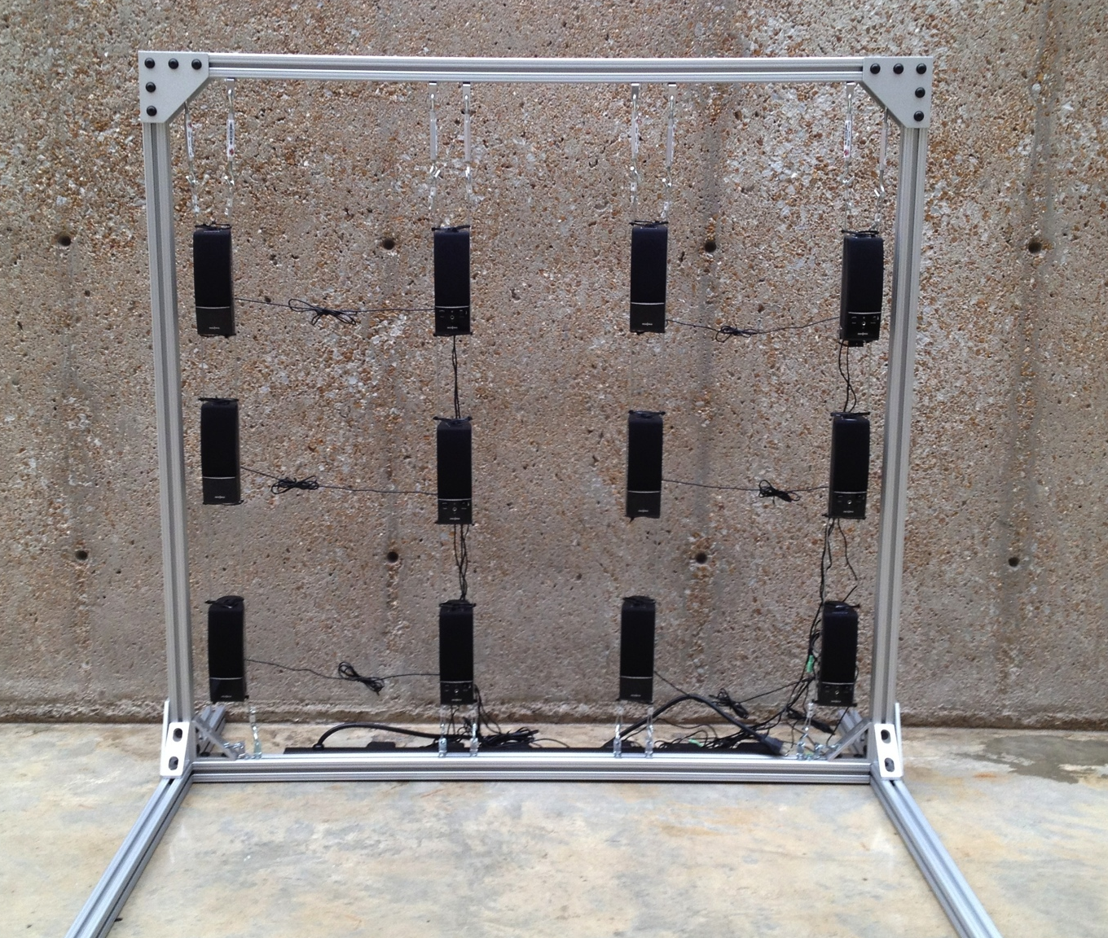
The Speaker Grid

Slide 4
Music Mixing
Concept
  Enable multiple audio files to mix and create a unified track
Default Track
  Signed 16-bit at a 44100 Hz
Clipping Prevention
  Determines max sample value of the mixed track
  If the max surpasses the threshold the rest of the track is divided by the ratio of (max/threshold)

Slide 5
Networking
Concept
  A client and server capable of streaming audio to individual speakers
Streaming
  Each client manages a single speaker and is fed a raw audio stream
Audio Playback
  ALSA captures data sent to virtual devices and packages it for soundcard playback

Slide 6
Conclusion
The Sound Pixel Project is fully functioning
  All audio tracks must be pre-loaded into the server then sent to be played
Future Projects:
  Real-time mixing
  Application interfaces to manage tracks
  Expanding the speaker grid
  Track motion with a Kinect

